Slide 1

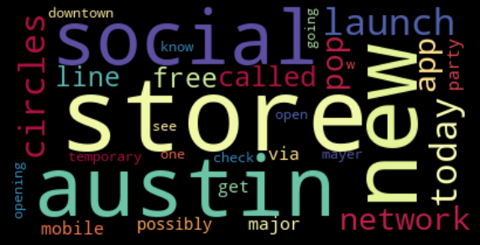
Twitter Sentiment Analysis
Vijaya Gunukula

Slide 2
Goal
The goal of this project is to perform supervised sentiment analysis on twitter tweets about google and apple products using Natural Language Processing and the model can rate the sentiment of the tweet based on its content.

Slide 3
Data
Obtained data from CrowdFlower
Source: https://www.crowdflower.com/data-for-everyone/
This dataset has tweets of human raters rated the sentiment in over 9000 Tweets as Positive, Negative or Neutral.

Slide 4
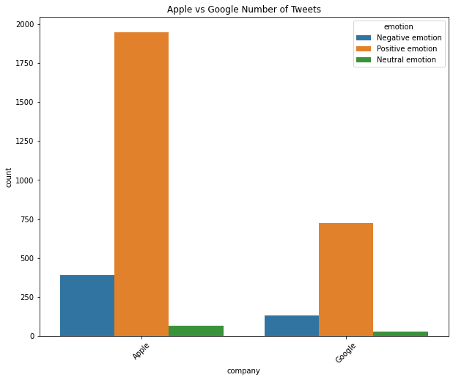
Number of tweets toward Apple and Google
More positive tweets on both companies that negative and neutral tweets
Apple has more tweets than Google

Slide 5
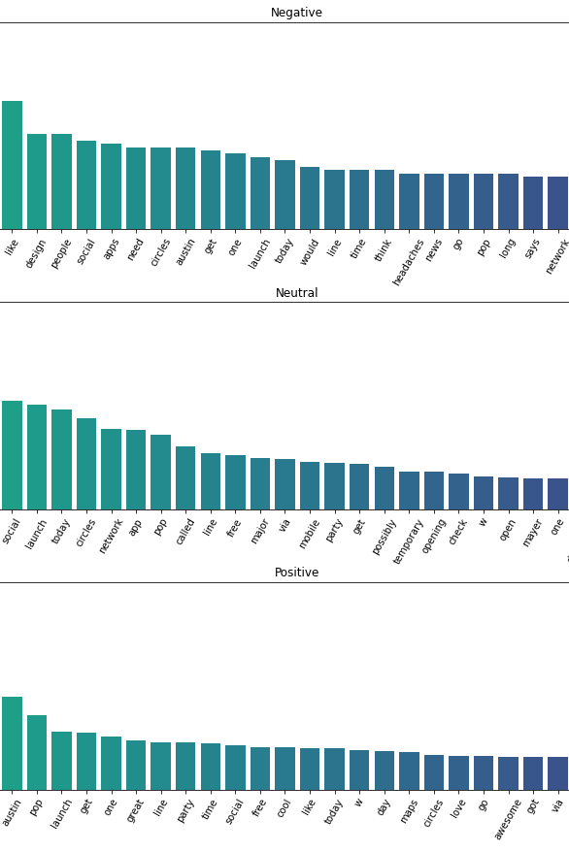
Top 30 words in tweets
The frequencies of the top 30 words in Positive, Negative and Neutral tweets

Slide 6
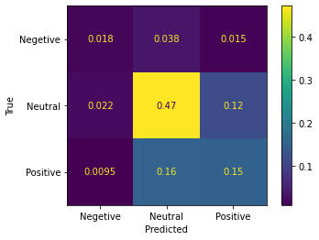
Model
Naive Bayes model as Accuracy –64%
Confusion of Matrix of multiclass of the Naïve Bayes.

Slide 7
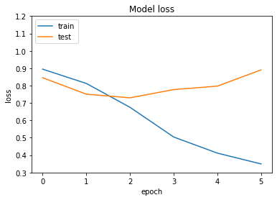
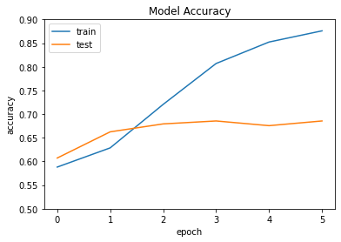
Deep NLP Model
Accuracy
Train set : 87%
Test set : 66%
Loss Function
Train set : 0.36
Test set : 0.97

Slide 8
Conclusion
Models performs better on training set than test set which leads to overfitting, to avoid this problem difference should be minimum.

Slide 9
Future Work
Adding more embedding layers and hyper parameters in the neural network model to avoid overfitting.

Slide 10
Thank You
Vijaya Gunukula
Email: vijayared@yahoo.com

